Slide 1

What’s that sound?
A General Purpose Automatic Audio Tagging System
Notes:
To change the image on this slide, select the picture and delete it. Then click the Pictures icon in the placeholder to insert your own image.

Slide 2
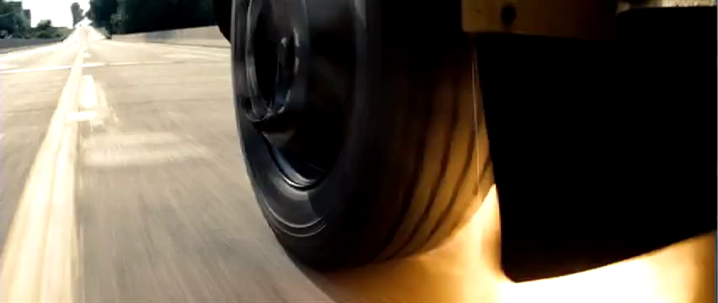
Non-Speech Video Annotation
Source: Man of Steel, 2013. Blu-Ray. Featured caption: [TIRE POPS AND KIDS SCREAM].

Slide 3
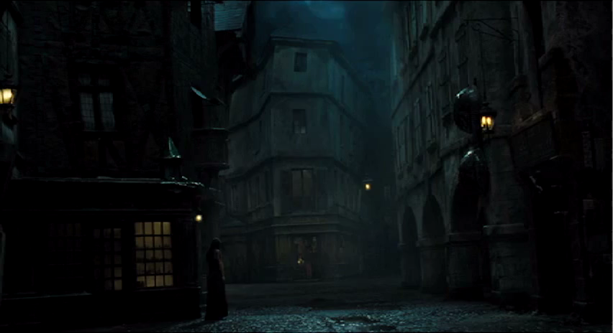
Non-Speech Video Annotation
Source: Les Miserables, 2012. DVD. Featured caption: (RAINDROPS PATTERING)

Slide 4

Public Security
Gunshot
Scream
Car Crash
Window Smash

Slide 5



What sounds?
musical instruments
human sounds,
domestic sounds,
animals
Vocabulary of 41+ labels from Google’s AudioSet ontology

Slide 6
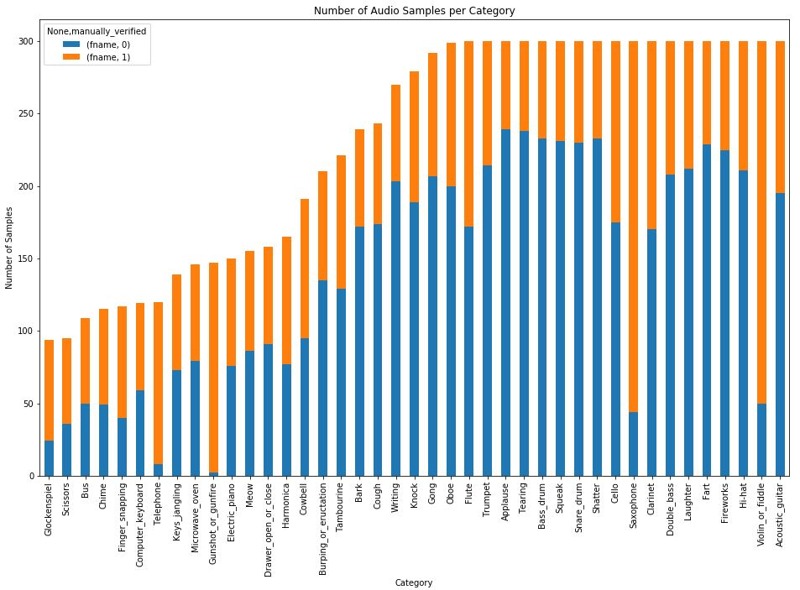
Class Distribution and Metric
Mostly balanced
accuracy will be a sufficient metric

Slide 7
My pipeline
Data Generator/
Preprocessing
CNN
Web App

Slide 8
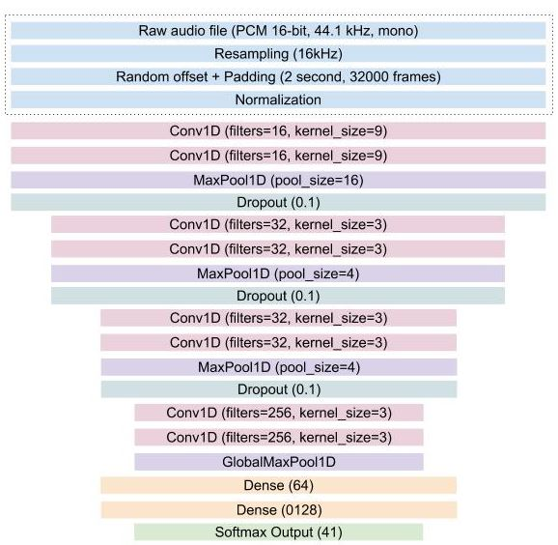
CNN Architecture
Data Preprocessing

Slide 9
CNN Architecture
Data Preprocessing
Convolution, Pooling, Drop Out Layers

Slide 10
CNN Architecture
Data Preprocessing
Convolution, Pooling, Drop Out Layers
Class Probability Outputs

Slide 11
Mean Accuracy
30% Accuracy

Slide 12
Application
TODO: GET VIDEO OF APP BEING USED

Slide 13
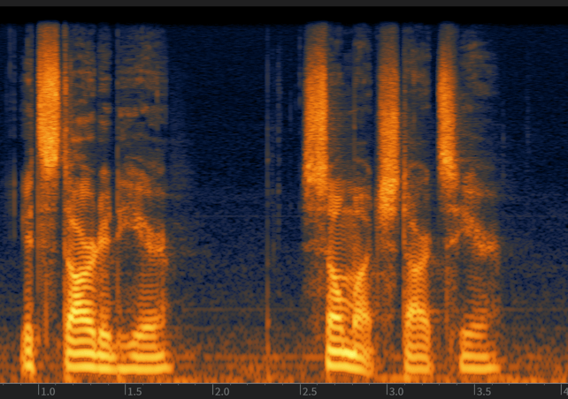
Future Considerations
Visual Representations of Audio
Mel Spectrogram
Transfer Learning
Data Augmentation

